Slide 1
Define
I am trying to lower my food expense in order to save money for housing payments. A little over a year ago, I got engaged and my Fiancé and I have been looking for a house since. While we have known about the price of a mortgage, we had no idea what other expenditures we had. When we started to look at expenses, our food budget was very high and in doing so contributed to a large portion of our monthly expenses. Being a necessity, we know we cannot eliminate this fully but would like to minimize it and relocate that money to savings.
Currently the average amount we spend a week is $436 and we are looking to lower that by $50 a week to add $200 back in our pockets. Before starting the project, we often went out to eat and found ourselves getting dessert quiet often as well. Taking that into account, we recorded the meal in which the purchase was being used for. Grocery store purchases seemed to account for a good portion of meals meaning that restaurants appeared to be more expensive, so we categorized that as well. In the summer months, we get out more often or are more active which means we need to eat more, we considered this in our equation to see how affective the month is to the equation. In a lot of cases at restaurants we give tips, seeing if the place we go, and tip, has an affect on the prices we pay may have an impact. We also accounted for the day of the week as it appeared most of our food purchases were done on the weekends. Does that mean they are more? This is something we want to see if it is affecting our food bills.
A successful implementation will result in us spending an average of $50 less per week than we are currently.

Slide 2
Operational Definitions
Amount : Average amount spent a week on all food (consumables)
Category : Defined by the merchants type of food (0 = Restaurant, 1 = Grocery, 2 = Other)
Meal : Defined by meal of day (0 = Breakfast, 1 = Lunch, 2 = Dinner, 3 = Dessert, 4 = Weeks lunches)
Tip Given : Defined by whether we tip or not at that merchant (1 = Yes, 0 = No
Month : Defined by what month of the year it is (1 = January … 12 = December)
Weekday : Defined by the day when the purchase was made (1 = Monday … 7 = Sunday)

Slide 3
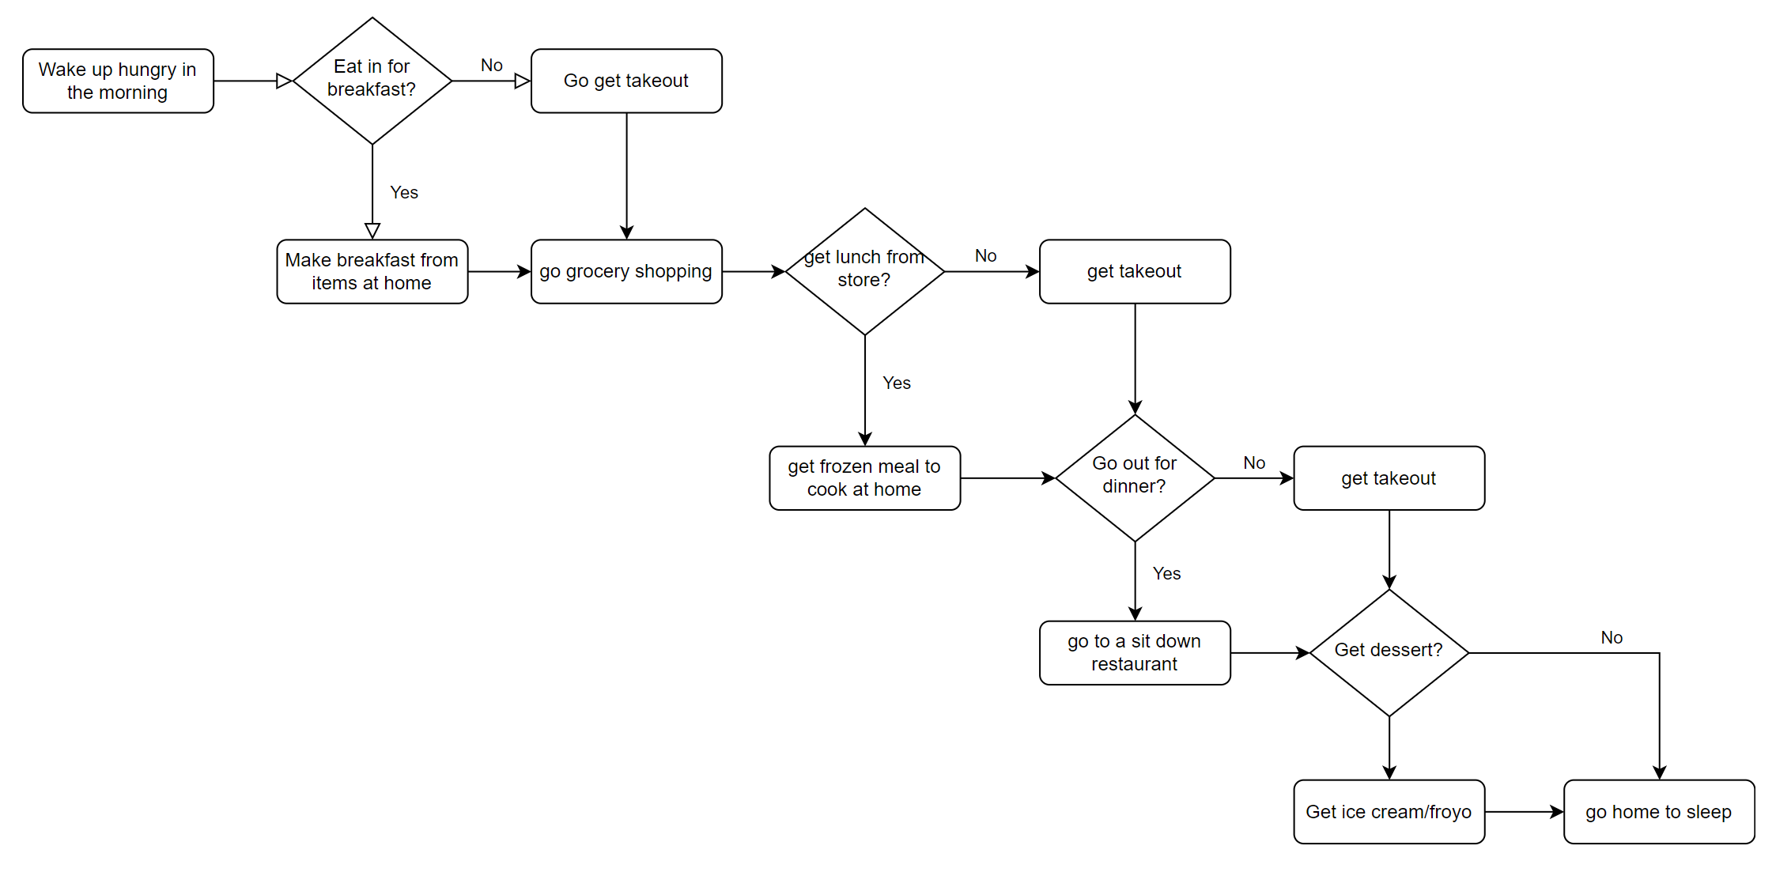
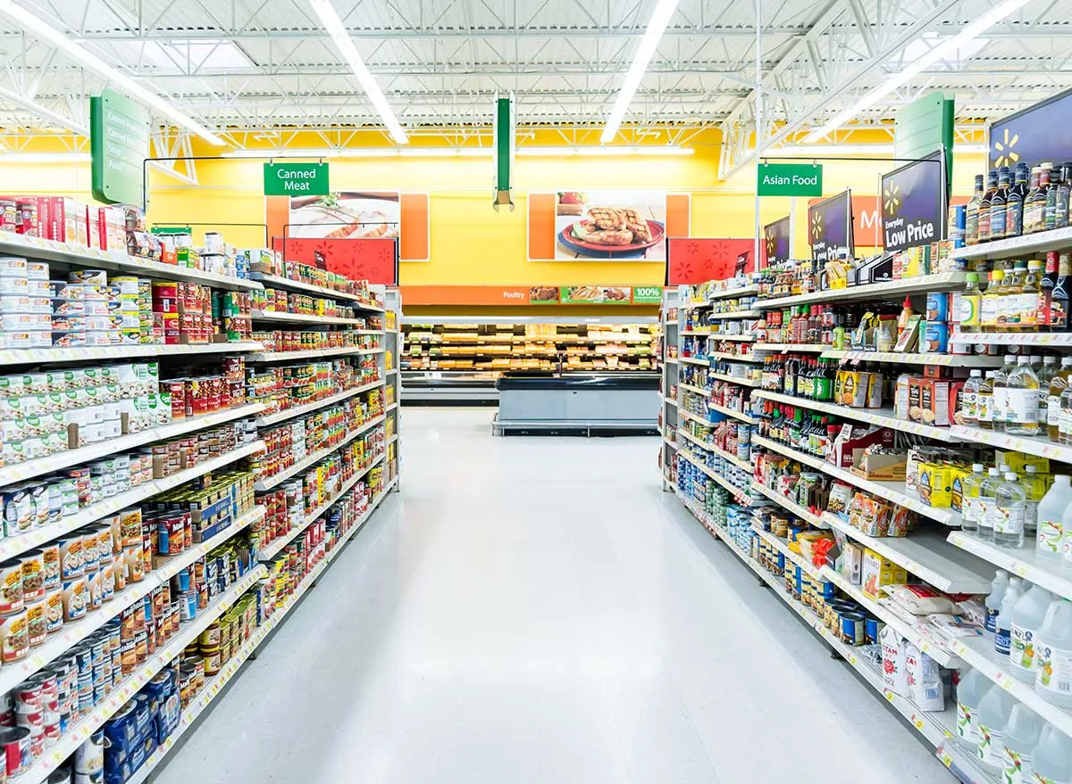
Process Map

Slide 4
Measure
Most of the data I collected was discrete data except for our output variable. All our X’s were discrete variables but were transitioned into categorical numeric values to be used with different tools.
All the data was collected from previous months credit card statements. Both mine and my fiancés credit cards were pulled and then combined and sorted. My accounts came from apple, chase, and bank of America, while my fiancés liberty bank account was used. These statements gave us the amount, merchant and the dates to which the purchases were made. The other discrete data is based on our memory of meals and our usual routine for certain foods and places we go throughout the week. Because we often have a routine of food, we were able to backtrack our meals to accurately account of all purchases.

Slide 5
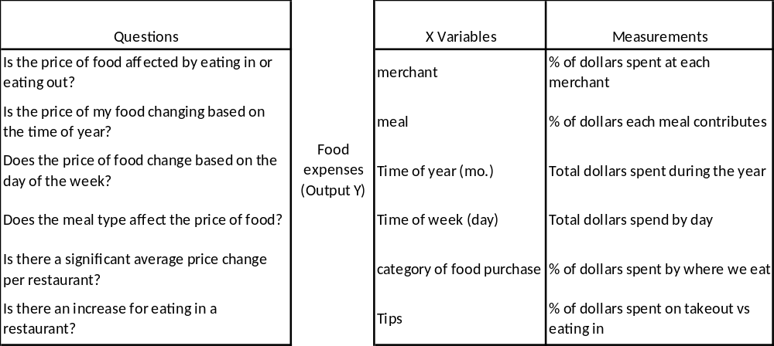
Data Stratification Tree
The observation data was made up of 30 weeks of purchases of food. This was taken over the course of 5 months mostly through the spring, summer and fall seasons.

Slide 6
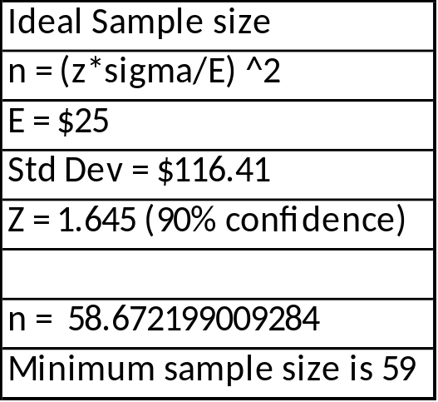
Sample Size
The confidence and error were based on our projects goals of reducing dollars spent by 50. A larger error or looser confidence would result in a smaller sample size but may make our calculations less accurate, so a compromise was made.
For this experiment, we collected only 30 samples which is about half of what is needed to have a strong confidence in our dataset. In order to really confirm our data, it would be ideal to have 60 or more samples before and after. This would ensure the 90 % confidence that the data we have is accurate and representative of the situation. The error we have is $25 because we are trying to confirm our average has dropped by $50 and this would give us enough room to be confident an improvement has been made.

Slide 7
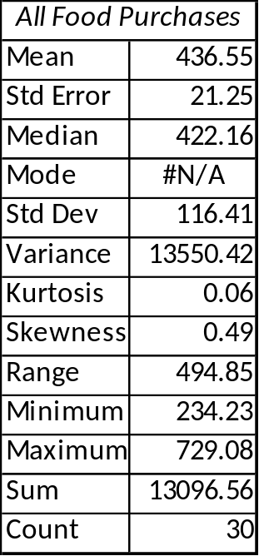
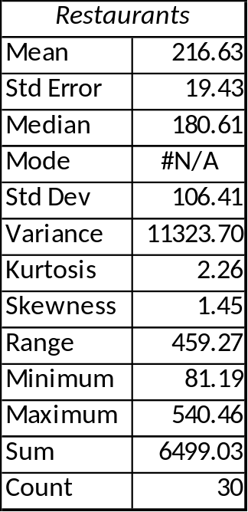
Descriptive Statistics
The main takeaways from this is the several similarities between the total food purchases and the restaurants. As restaurants rise it appears the total rises as well and the values are off by a magnitude but still appear somewhat correlated to each other.
The mean for total food purchases is $436 with a standard deviation of $116. This is a very spread-out dataset also see in the range of $494. The median is somewhat close to the mean but appears a bit off, which is likely caused by an outlier of $729 that occurred in week in May. The next closest was $635 which is almost 100 less and can confirm this may be an outlier.

Slide 8
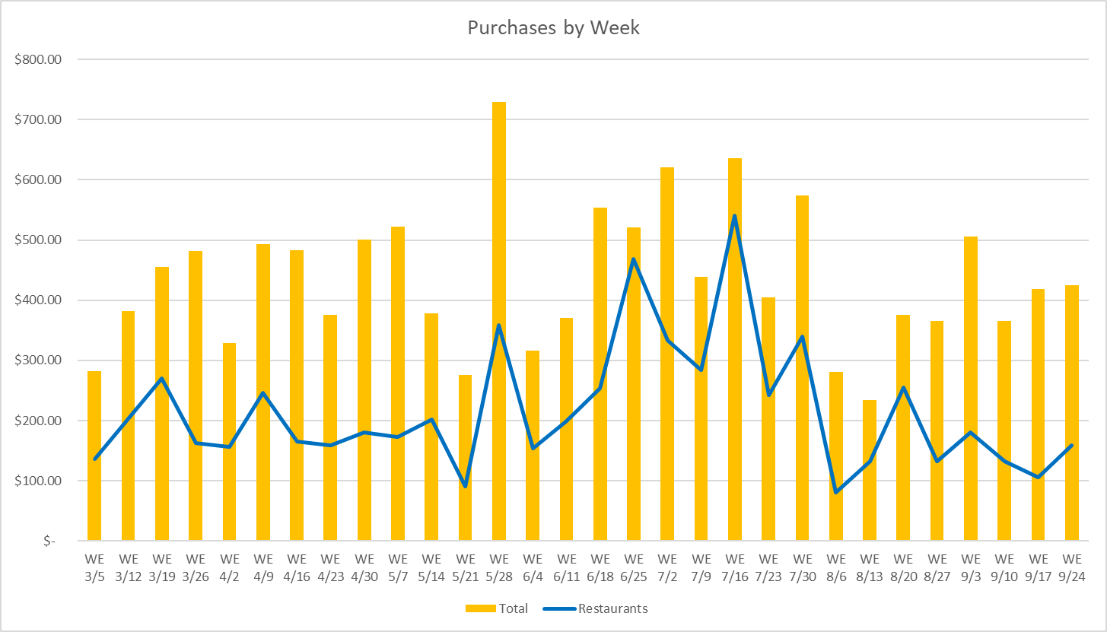
Histogram/ Trend Chart
The chart shows the correlations between the restaurants amount and the total amount. The two appear to rise and fall which there may be some correlation between going to restaurants and the increase in food cost.

Slide 9
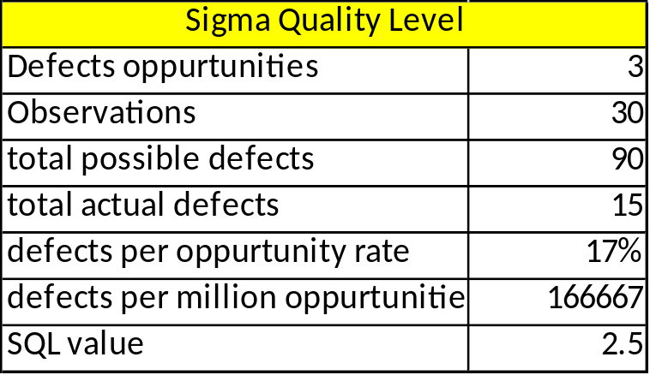
Analyze : Sigma Quality Level (SQL)
The main defects we saw were 1. someone else is paying for our food and is not recorded, 2. We buy nonfood items in our purchases (i.e. paper towels or aluminum foil), 3. We buy more food than we needed, and we throw some of it out.
SQL is used to baseline our data collection and measure how variable our process is. The value of 2.5 is low which means we have a good amount of variability, and we aim to increase this number to prove we are eliminating possible errors in our system.

Slide 10
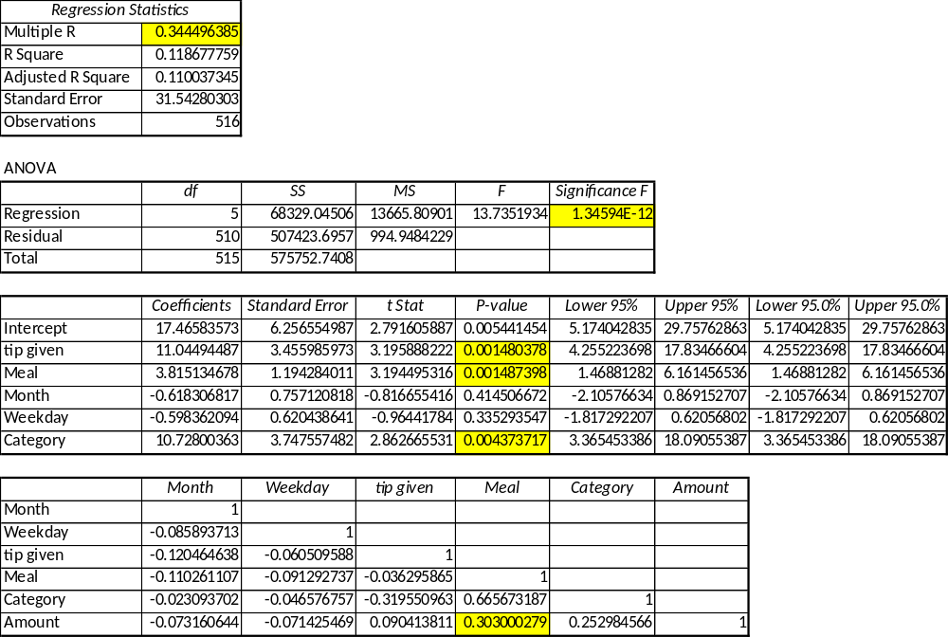
Analyze : Multiple Regression
Not a great correlation for this equation. The 0.34 shows they don’t have a strong correlation. Many different factors can be associated with this figure.
The equation is statistically significant.
Tips, meal, and category are significant determiners of the amount the purchase will be. Tips and category affect the amount the most see by the high coefficients, but the meal is the most correlated variable with a 0.3 value.

Slide 11
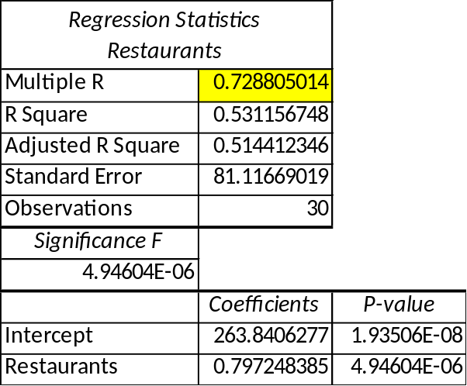
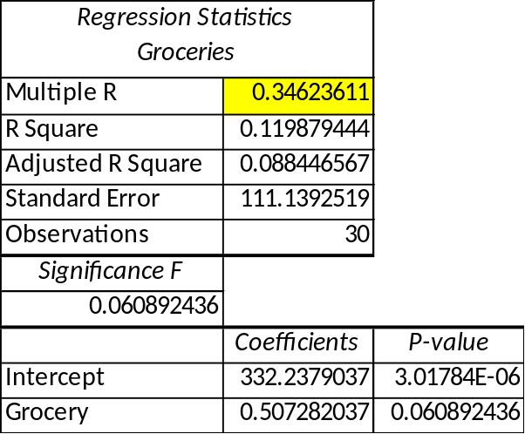
Analyze : Simple Linear Regression/ Correlation
The simple linear regression was used to dive deeper into the category variable. This variable was chosen due to its fairly high impact in the overall equation (coefficient of 10.7) as well as a correlation of 0.25 to the amount output variable. Restaurants has a very high correlation of 0.73 and has a very strong significance as it is well under 0.05. Groceries on the other hand is not as good at explaining the change in amount as it has a correlation of 0.35 in its linear regression model. The groceries significance is also not acceptable as 0.06 is slightly over the 0.05 threshold. It appears the restaurants rise, and fall can be associated with the amount spent per week. This will be something to investigate and reduce in the following weeks.

Slide 12
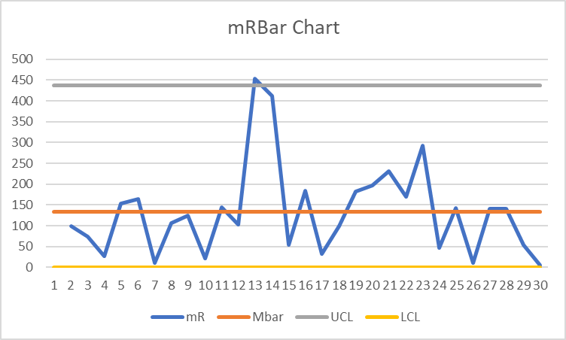
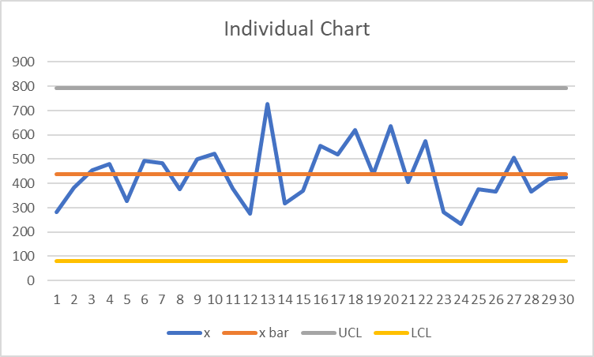
Improve : Control Charts
The moving range and individual control charts were chosen because we have individual samples with the continuous data in terms of money. The data appears to be very sporadic and does not seem to trend in any way. There is an out-of-control data point at number 13. looking back at the data I could not find an event that would have caused this, but it is possible that food was purchases for someone else. The individual chart appears to be fully in control and random which is something we are looking for. The problem I see is the large variability in these charts. The range of control is quite large and hopefully this can be reduced in the next stages. We will also be looking the restaurants only control charts to see if that is different.

Slide 13
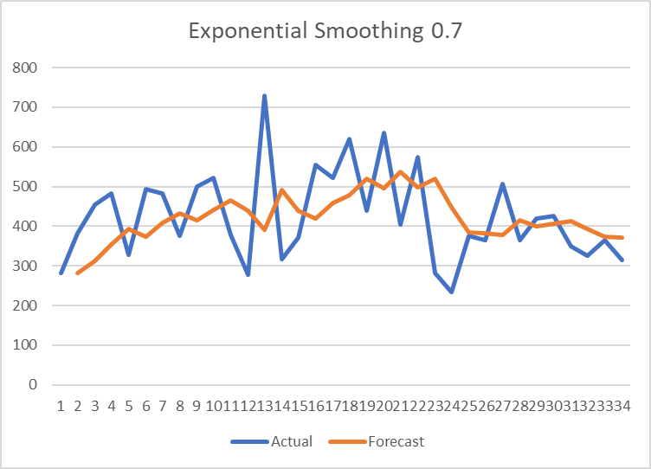
Control : Time Series
The time series analyses on the right was performed using Exponential Smoothing as the method. This graph shows an increase in the center of it and then a quick drop off after the changes were made. The damping factor was 0.7 which takes 70% of the previous forecast and 30% of the previous actual to predict the newer forecasted value. There is not much of a relationship between y and f(y) in this dataset but near the right end of this data we can see a smoother forecast which may indicate a more in control process. This is a nice output because we can tell that around week 25, we are downward trending and predict it to drop lower as the week go on. Hopefully, we can continually improve this and have better results than initial hopes.

Slide 14
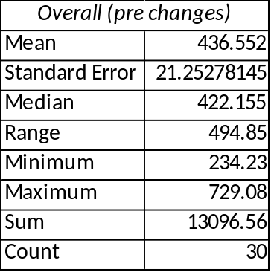
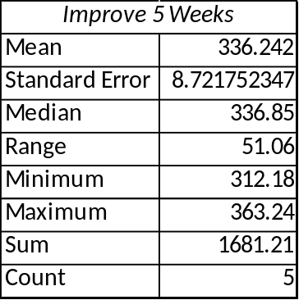
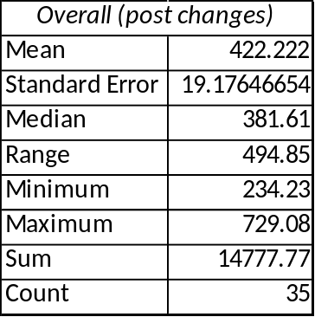
Control : Change in Descriptive Statistics
When going back and look at the changes in our basic statistics we can see an overall decrease in our figures. Based on this simple statistics we see a $100 drop in overall expense by week. This decrease has helped reduce the overall amount by $14 over the full 35 weeks that the expenses were measured. These basics do include any outliers which may be present but is a simple way to view the change that occurred. The final 5 weeks of change did not have much variation which may prove to show a better future state control. On the other hand, there may not have been any major occurrences or there was some reason why a week which may have been higher had been diminished due to another factor.

Slide 15
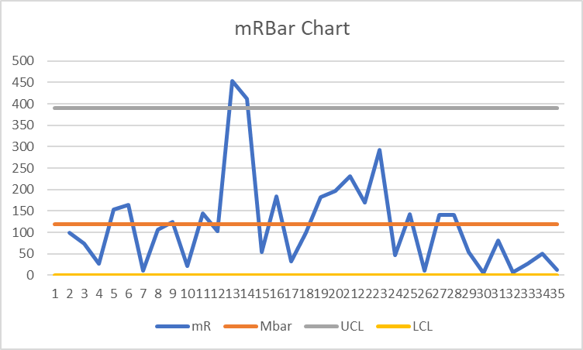
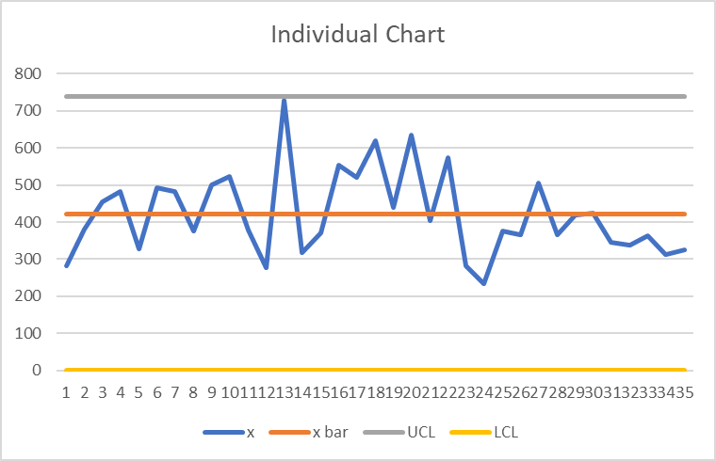
Improve : Control Charts
Post changes
After week 30, the full implementation of limiting the number of times we eat out has show a large decrease in the overall trend and forecast of our data. In both the mRBar and the Individual line charts we see that post week 30 the line stays below the averages for each graph. This decrease and continual decrease shows that we may have made a new average for our data. This would need to be run over many more samples as proven in our sample size formula but the initial change can prove a difference was made. This difference may or may not meet our goal of saving $50 a week but for the time being I am a lot happier knowing that our efforts and the investigation of the data has let us to findings to make actions to reduce our food expense.

